Slide 1

Use case 8: Microservices with docker-machine and docker-compose
Goal:
Introduction to docker-machine
Introduction to docker-compose
Introduction to using docker-machine with docker-compose
Introduction to Docker for Java Developers

Slide 2
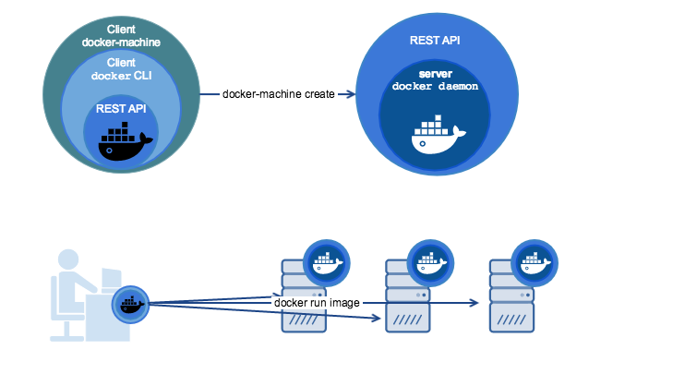
Use case 8: Microservices with dock-machine and docker-compose
What is Docker-Machine?
Docker Machine is a tool that lets you install Docker Engine on virtual hosts
Introduction to Docker for Java Developers

Slide 3
Use case 8: Microservices with docker-machine and docker-compose
Virtual Host 1
IP: 172.0.0.1
Virtual Host 2
IP: 172.0.0.2
Container-1 MYSQL
Container-2 Java
Container-1 MYSQL
Container-2 Java
Host Operating System (Windows, MAC OSX, Linux)
Docker Engine
Infrastructure / Server
Introduction to Docker for Java Developers

Slide 4
Use case 8: Microservices with docker-machine and docker-compose
Docker-machine pre-requisite : Set up in WINDOWS
Introduction to Docker for Java Developers

Slide 5
Use case 8: Microservices with docker-machine and docker-compose
Summary:
Docker Machine
Starting and Stopping machines
Finding the IP address of machines
Activating a machine and deploying images.
Docker Compose
Building an Image (docker-compose build)
Running a container (docker-compose up)
Build and RUN an Image (docker-compose up --build –d)
- Stopping a container and starting a container
Tailing logs
Building just one microservice and running a container
Introduction to Docker for Java Developers

